Slide 1

TOPIC:
NAME OF MEMBERS:
GUIDE NAME

Slide 2

INTRODUCTION
Welcome to the presentation on "ReBookify: Empowering College Students with a Thriving Second-Hand Engineering Book Marketplace."
This mini-project aims to develop a web application that facilitates the buying and selling of second-hand engineering books within a specific college community.

Slide 3


PROBLEM DEFINITION(AIM)
THE PROBLEM: DIFFICULTY IN FINDING AFFORDABLE ENGINEERING BOOKS FOR COLLEGE STUDENTS.
SOLUTION: CREATING A WEB APPLICATION THAT ALLOWS SENIOR STUDENTS TO SELL THEIR OLD BOOKS TO JUNIOR STUDENTS WITHIN THEIR COLLEGE COMMUNITY.

Slide 4

SCOPE AND MOTIVATION
Scope:
Web application for a specific college community.
User registration, login authentication, and profile management.
Senior students can create listings for their books.
Junior students can search for books and contact sellers through the website.
Motivation:
Facilitate affordable access to engineering books.
Encourage reuse of educational resources.
Promote financial assistance for students in need.

Slide 5





TOOLS & TECHNOLOGIES(HARDWARE AND SOFTWARE)
Programming Languages:HTML, CSS,JavaScript, Python
Frameworks: Django, Bootstrap
Database: MySQL
Version Control: Git
Hosting: Heroku

Slide 6

WORK PLAN
Phase 1: Project Setup and Requirement Gathering
Define project objectives and scope
Gather requirements from stakeholders
Phase 2: Design and Development
Design the user interface and website layout
Implement user registration, login, and profile management
Develop the book listing functionality
Phase 3: Testing and Deployment
Conduct testing and debugging
Deploy the web application on Heroku

Slide 7

CONCLUSION
In conclusion, ReBookify aims to empower college students with a thriving second-hand engineering book marketplace.
By providing a user-friendly platform, we facilitate the buying and selling of books within a specific college community.
This project promotes sustainable practices, financial assistance, and accessible educational resources.

Slide 8
REFERENCES

Slide 9
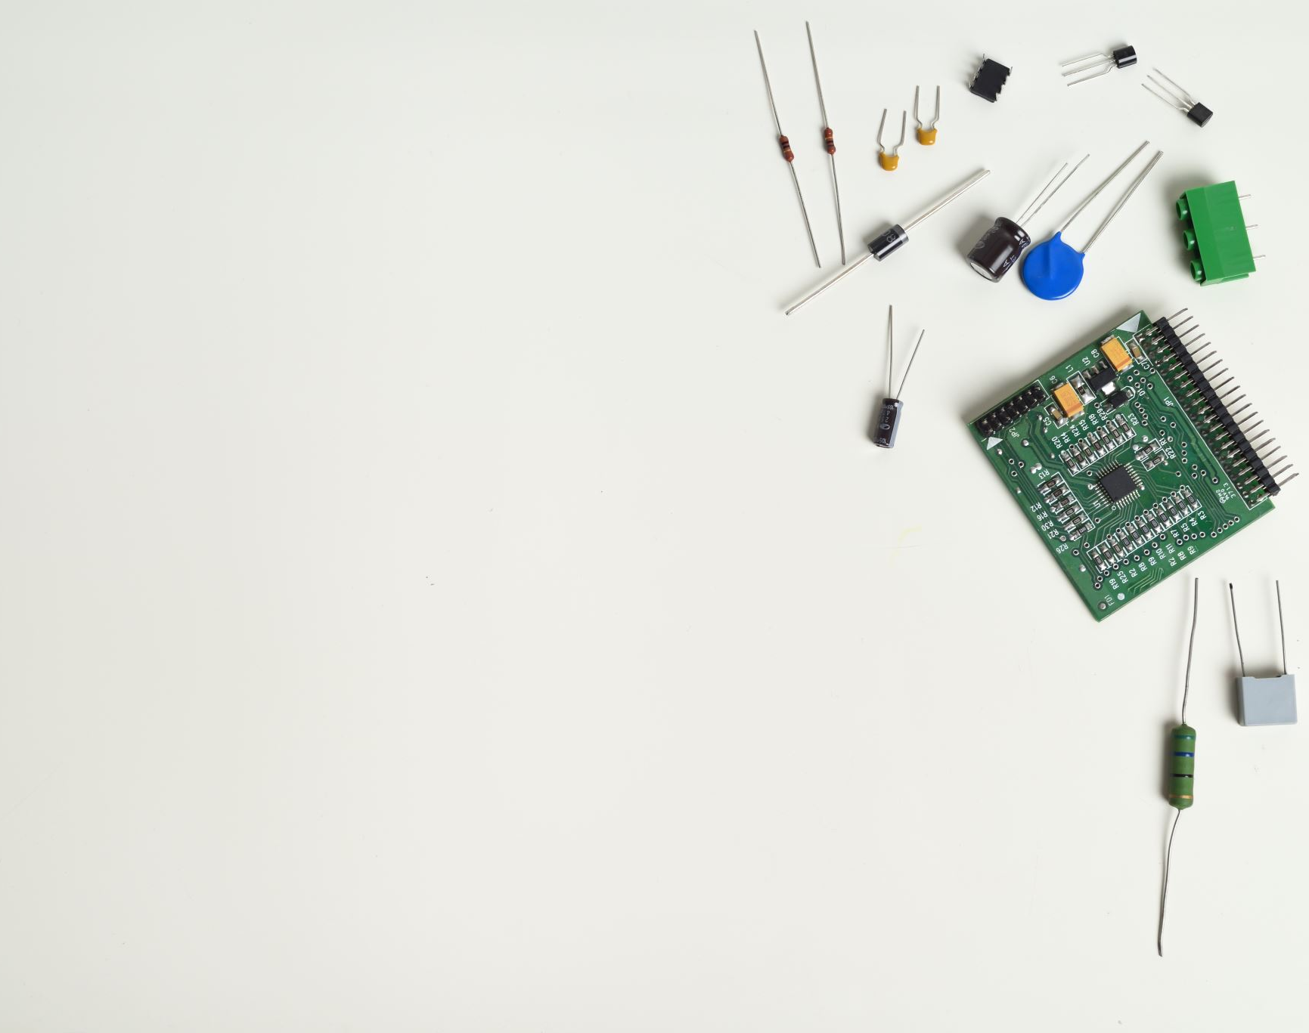
Team Members:
Christom Joseph
Geo Mathew Gregory
Salviyas Sojan
Project Guide:
Dr. Priya Mariam Raju
Project Coordinator:
Ms. Taniya Shirley Stalin
THANK YOU

